Slide 1


Dos Attack against HTTP protocol using incomplete request
By: - MAYANK AGARWAL
E16CSE145
Notes:
Add Caption : Expect More

Slide 2
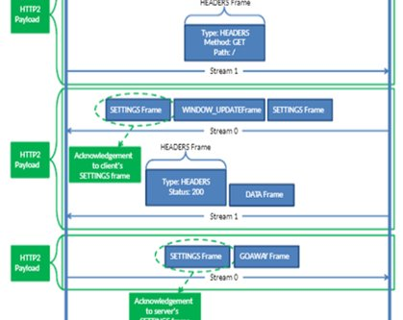
INTRODUCTION ABOUT TECHNOLOGY
Protocol used by worldwide web​.
Defines how messages are transmitted and formatted over the internet.​
Helps in data exchange between two end points over the internet.
HTTP Parameters
HTTP messages are divided into different frames having different features like:-​
Connection Preface establish settings for HTTP/2 connection.​
HEADERS and CONTINUATION Frames carry a header block and to transmit remaining parts of header block .​
DATA Frame carry message body sent by the endpoints.​
WINDOW UPDATE Frame indicate the number of bytes that the sender accept by its peer. ​
GOAWAY Frame tear off established connection between end points.

Slide 3

MOTIVATION OF THE PROJECT
Prevent Loss of Confidential Data.​
Prevention from cyber-attacks.​
Used in every field like Healthcare, Financial sector and many more.​
To prevent from any cyber ransom against any confidential data.​
Prevent any website from going down and denying service to users.​
Providing a layer to existing security to make it better.

Slide 4
Quality/Outcome/Success
As mentioned in the first milestone, I have successfully launched denial of service attack on different server and had developed detection scheme which is almost working 8 out 10 times. Also I mentioned I will develop different kind of attack and I have developed some other attack also which has accuracy of 70-80% . I a not able to develop a UI for my project because my project requires a lot of research work and developing attacks requires lot of time and I had learned lot of things during this project and I am satisfied with it.
Out of 10, I would give myself 7.5 as I was very consistent for my project work but still, I only succeeded in 75% competition of project which is good for me.

Slide 5
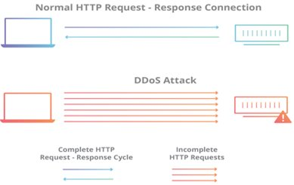
TECHNICAL BRIEF
This attack is example of slow-rate attacks means attack parameters are slowly sent again and again to server. ​
The attack works by tying up or continuously consuming server resources by sending legitimate incomplete HTTP requests to and making server to wait for complete request and reserve the resources available for open connection waiting for their completion.​
The complete HTTP request sent to server always ends with a line as \r \ n, which is always followed by an empty line which signifies the end of the request and it is necessary to complete the request. ​

Slide 6
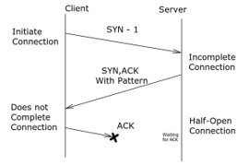
TECHNICAL BRIEF
The attacker removes these lines and sends incomplete request and the server must wait for the end of the request so the half open connection can be completed, and the server waits for a specific timeout before it closes connection.
This timeout is restarted again when the attacker sends the next packet containing incomplete request, so the server again wait for same time for request to get completed. Thus, in this Slow HTTP attack, the attacker never sends the final line/ complete request to the server in order to keep the connection half open as long as possible which results in denial of service to another user.

Slide 7
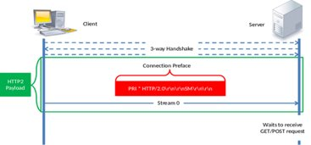
RESULTS
The attack was tested on 4 different server in which attacker send incomplete request the server again and again .​
The attacker removes these lines and sends incomplete request and the server must wait for the end of the request so the half open connection can be completed, and the server waits for a specific timeout before it closes connection. ​
There were multiple request being sent to the server and at a point of time all resources of servers were consumed and resulted in denial of service attack.

Slide 8
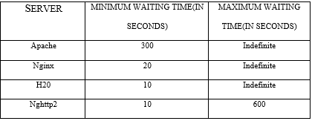
RESULTS
The attack was tested on 4 different servers used globally and which all are based on HTTP method for transmitting and receiving data from client.
The following result was found that the maximum waiting time for Apache, Nginx, H20 are indefinite for all which is only in case when client does not send any data to server after sending get or the post request after 3-way handshake has been completed between client and the server.
Table 1: Test on different server

Slide 9
I had successfully launched attack oh Apache server and had also made detection scheme that how one can be get protected itself from the attack based on IP address.​
I had written a python script which will detect the Ip so one can manually block them which is like the sniffer. ​
As of now I successfully completed one attack and had written script for other attack, but they have accuracy of about 75-80% of successful attack. I have done lot of research which is also a part of my goal or vision​
Found that Apache server is vulnerable to the attack if there is no firewall or sniffer.
RESULTS

Slide 10
FUTURE WORK
I will make a very interactive and attractive UI for my project in which one can just simply press a button and everything will be done automatically at the backend and IP are automatically blocked, so their packets are drop out and never reach to the server. ​
Also, I would find some more better vulnerabilities and their defense mechanism so I could help many more people.​
I would try to convert my project into product for organizations and make it to work for android and iOS devices also. ​
This project can also be improved by adding some different attack vectors because it will add other layer of security to my project.

